Slide 1



BUSINESS DATA MANAGEMENT
CAPSTONE PROJECT(MAY 2024)
BY SHAKTI SONI(22F1001845)
22f1001845@ds.study.iitm.ac.in
Storesafe: Grocery Risk Assessment
CASE STUDY OF :- Agrawal Soap Works & Kirana Store
Page 1

Slide 2

CONTENT
01
INTRODUCTION
02
DATA COLLECTION & CLEANING
03
ANALYSIS WITH RESPECT TO PROBLEM
04
IMPORTANT INSIGHTS
05
SOLUTIONS/RECOMANDATION
Page 2

Slide 3
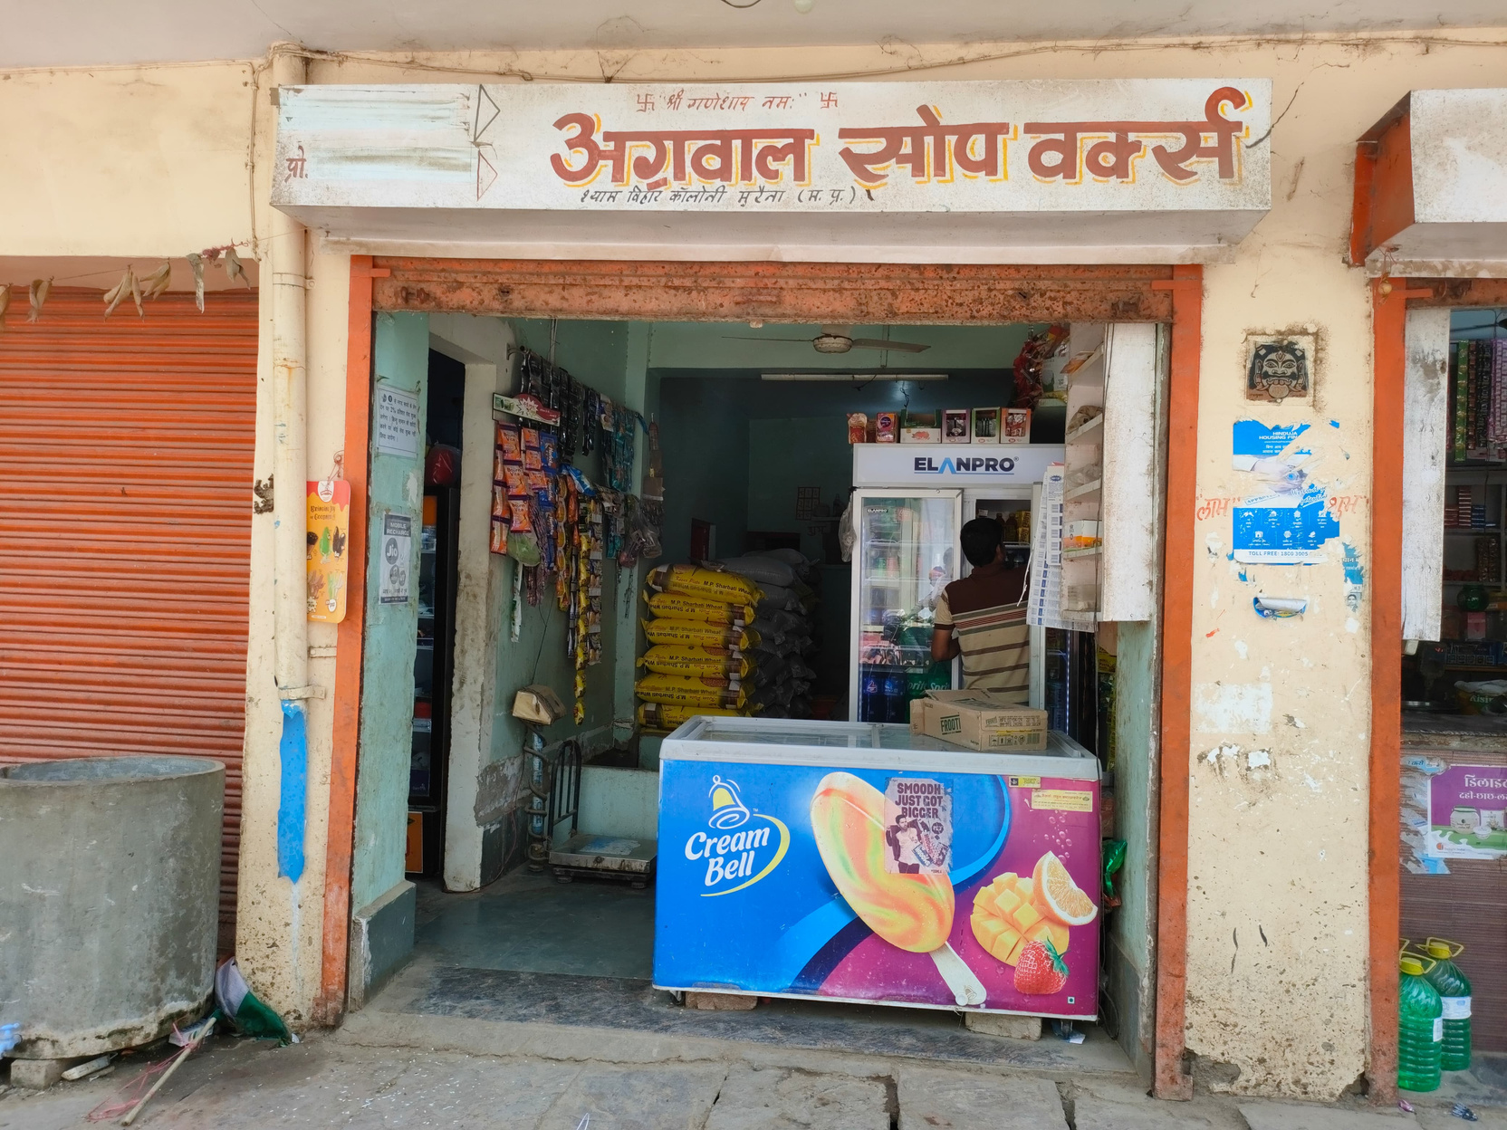

INTRODUCTION
The shop from which I have collected the data is Agrawal Soap Works and Kirana Store, which is a Kirana shop based in Morena, Madhya Pradesh
The shop was launched by Mr. Amit Goyal in year 2016. The store is currently owned by Mr. Amit Goyal and managed by his son, Ayush Goyal.
Page 3

Slide 4
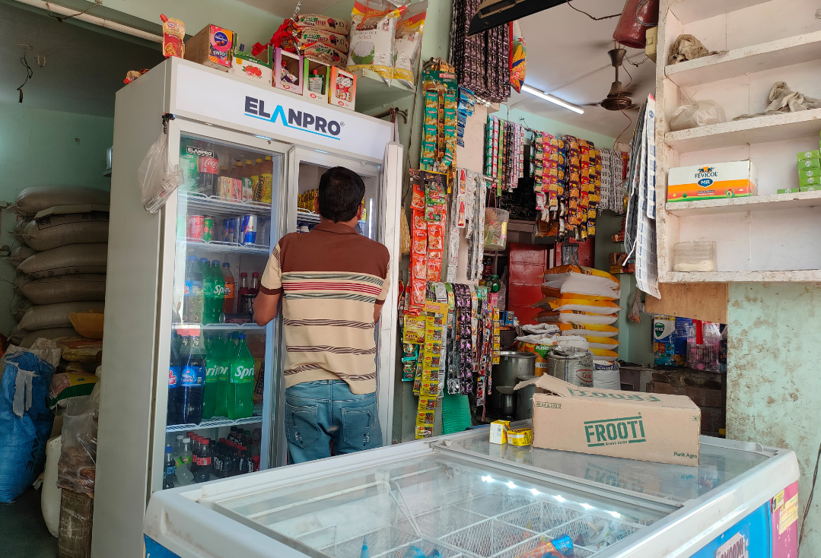

PURPOSE OF CASE STUDY
Objective n° 1
Objective n° 2
Objective n° 3
To Find the customers loyalty
To Identify best selling category
To identify Best Selling product among all.
Page 4

Slide 5

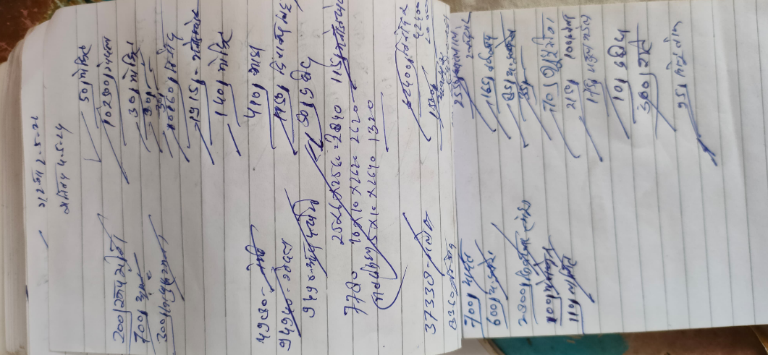
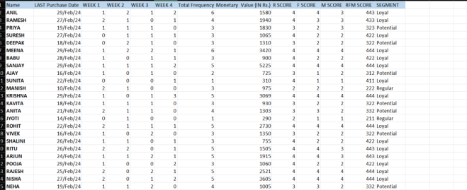
Data collection and cleaning
Data collection
To collecte the data I visit to the store on the regular basis in the month of febraury 2024
Data collected for the analysis was primary and very raw
Cleaning
Hence to Consolidated and clean the data Google Sheets/Excel was used for data cleaning and future analysis.
Page 5

Slide 6

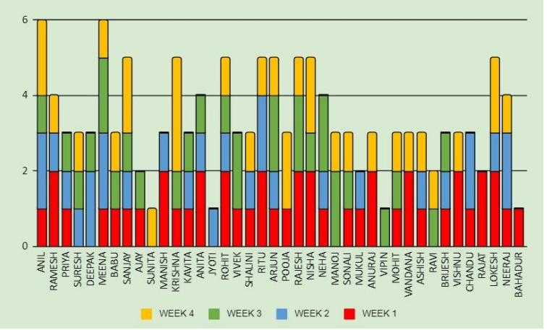
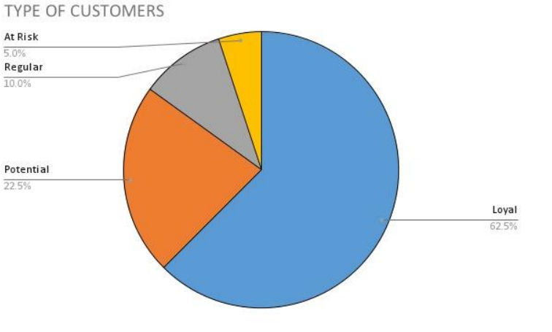
ANALYSIS WITH RESPECT TO PROBLEM
1. Customer loyalty
The above figure shows the percentage of different customer segments that visited the store in
February. It is evident that most customers are loyal, some are potential customers (meaning
they depend on a small number of products from the store), a small percentage of regular
customers (meaning they visit occasionally but not frequently), and a very small percentage of
at-risk customers (meaning they visit occasionally, maybe once a week or twice a fortnight)
Page 6

Slide 7
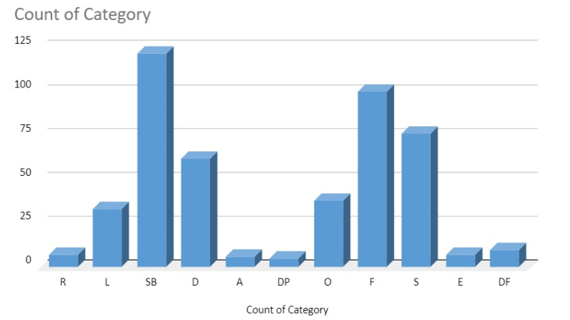
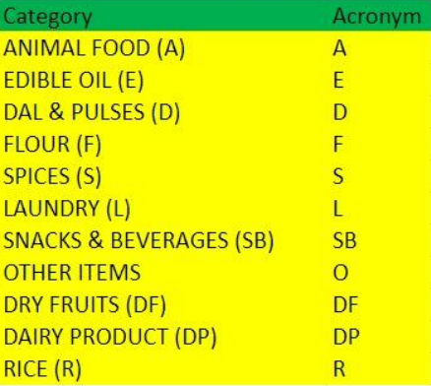
2. Count of categories sale
CUSTOMERS
The question raises an issue that owners of retail firms frequently deal with knowing client
preferences by category is essential to efficient inventory control. Owners can avoid
overstocking or understocking by evaluating which categories sale better and which are less
popular and then optimizing their inventory accordingly.
Page 7

Slide 8
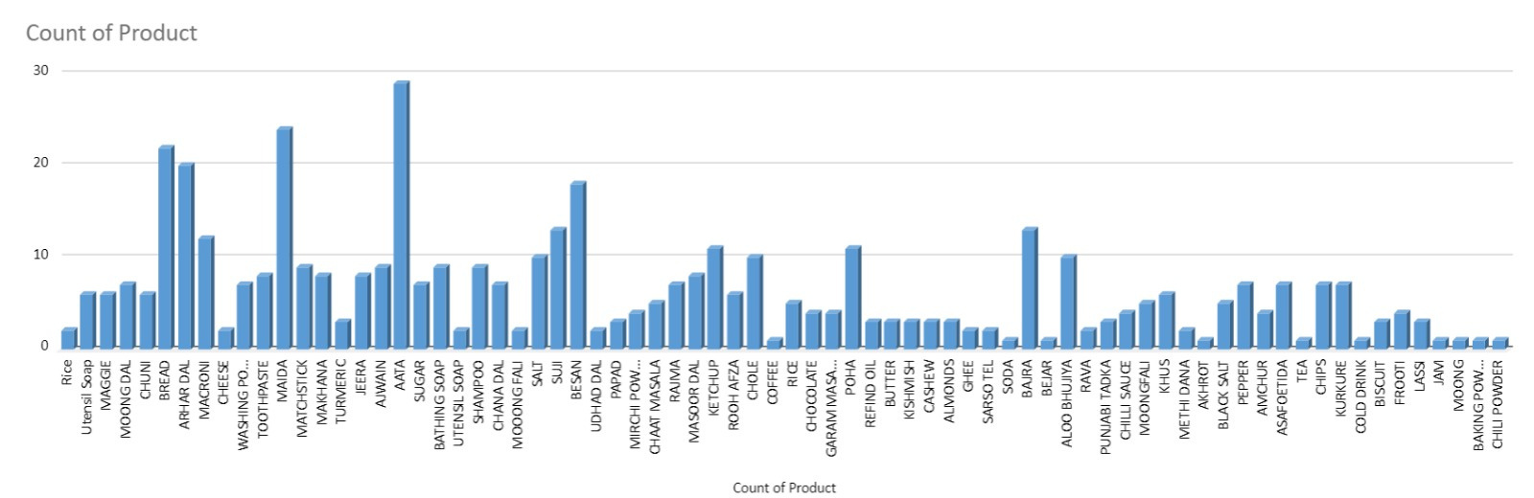
3. Count of products Sale: -
CUSTOMERS
Product-Centric Inventory Management:
Understanding product preferences and sales trends by category is vital for tailoring inventory levels to meet demand accurately.
By identifying high-selling Products, owner can ensure adequate stock levels to prevent stockouts and enhance customer satisfaction.
Page 8

Slide 9



IMPORTANT INSIGHTS
Snacks and beverages are the most sold category in the shop, indicating that these products have the highest demand among customers
Aata (flour) is the best sold product in the shop, with 29 customers purchasing it. It belongs to the flour category and generates the most profit for the shop.
INSIGHT N°1
INSIGHT N°2
INSIGHT N°3
62.5% are loyal customer 22.5% are potential, 10% are regular & 5% are at risk
Meena and Anil are most frequent visitors (6 times)
Followed by Sanjay, Krishna & Ritu (5 times)
Page 9

Slide 10
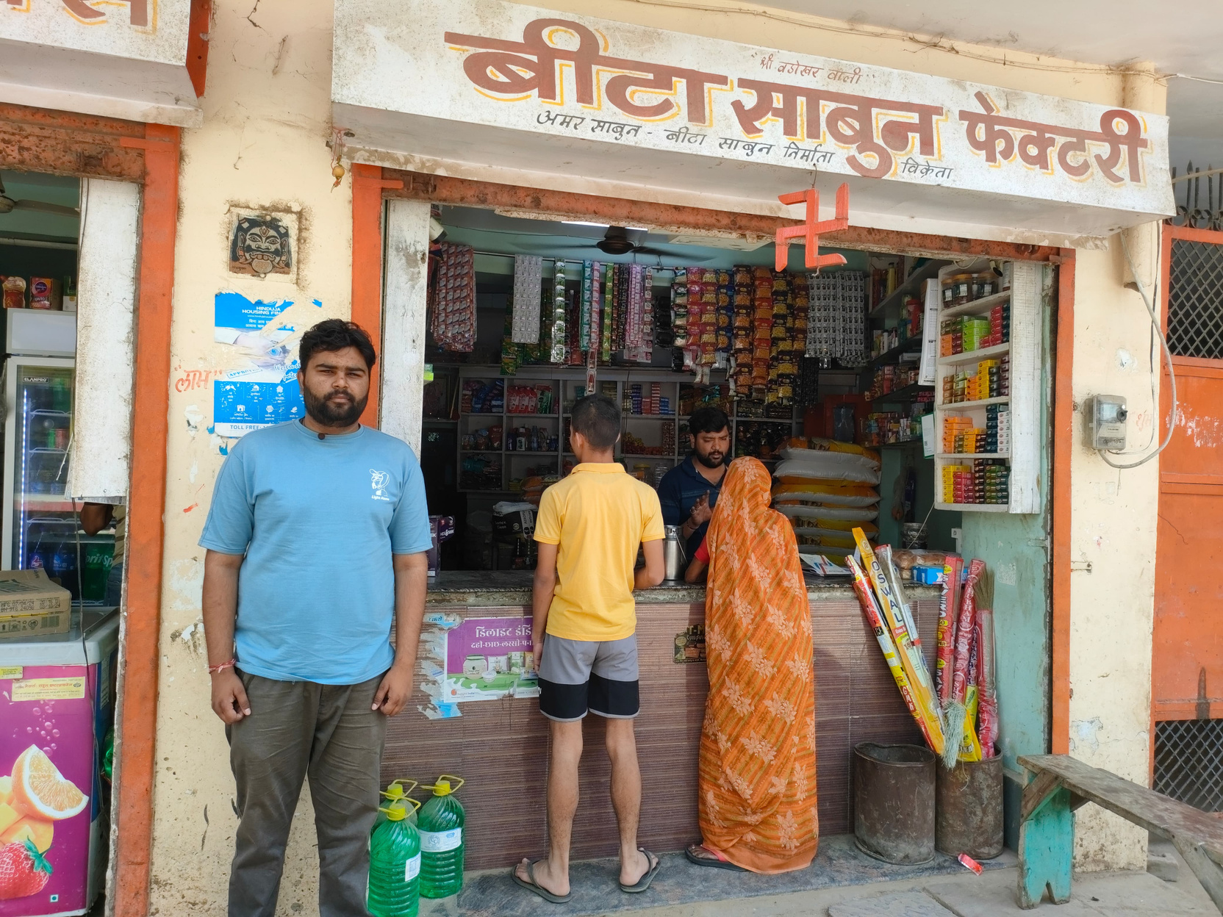
SOLUTIONS/RECOMANDATION
Target Potential Customers
Retain At-Risk Customers
Understand Customer Preferences
Improve Customer Service
Capitalize on Best Selling Categories
Diversify Product Range
Page 10

